Slide 1


Strathmore Actuarial Student's Society R Training Program Shelmith N. Kariuki

Slide 2





Statistical Languages

Slide 3
Statistical Languages (Data Science)

Slide 4
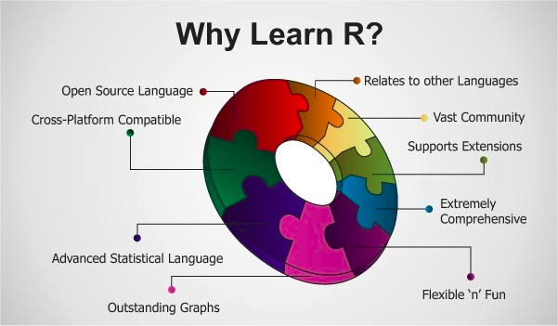
Why use R?

Slide 5
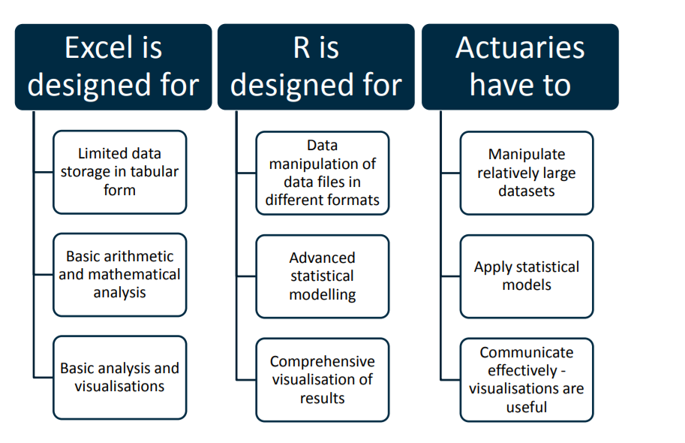
Why use R? Cont’d

Slide 6
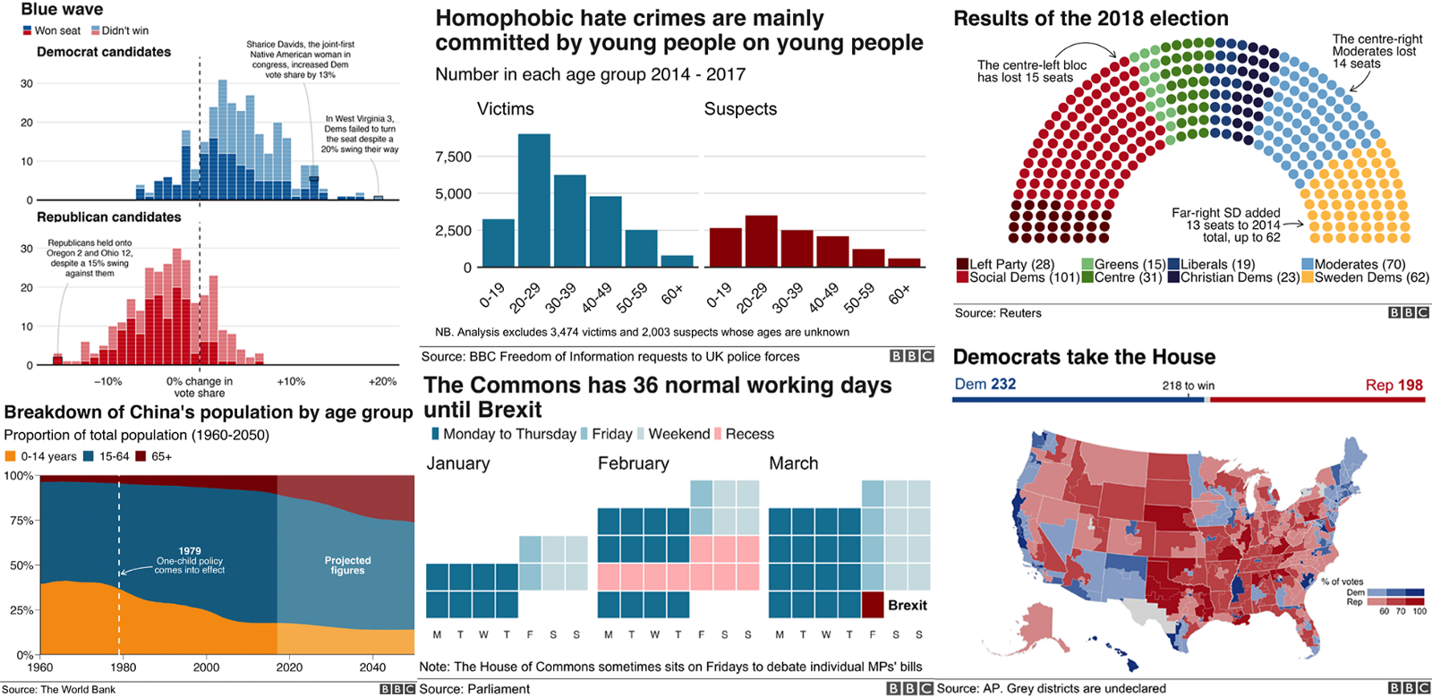
General Use Cases

Slide 7
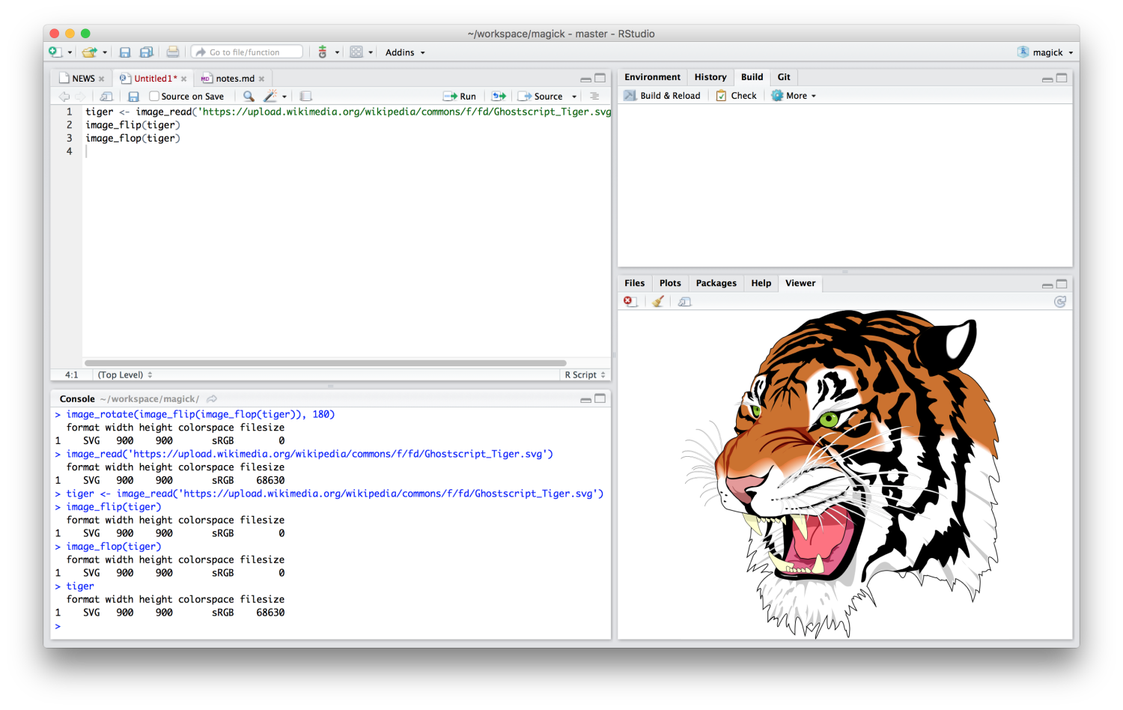
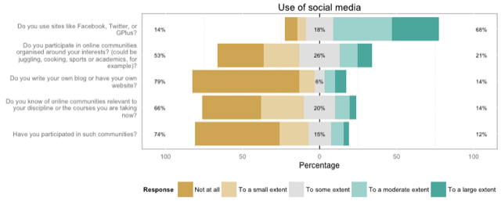

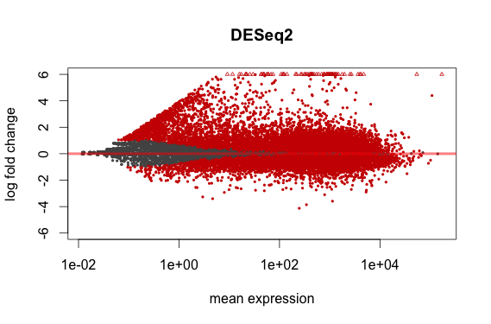
General Use Cases: Cont'd

Slide 8
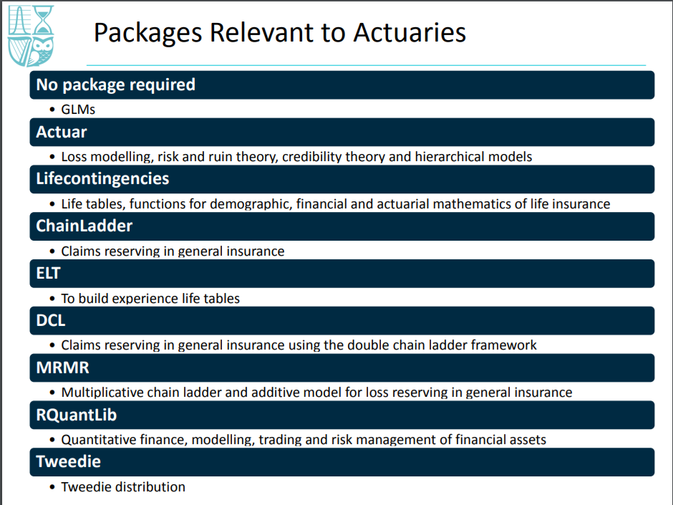
Use Cases: Finance and Actuarial Science

Slide 9
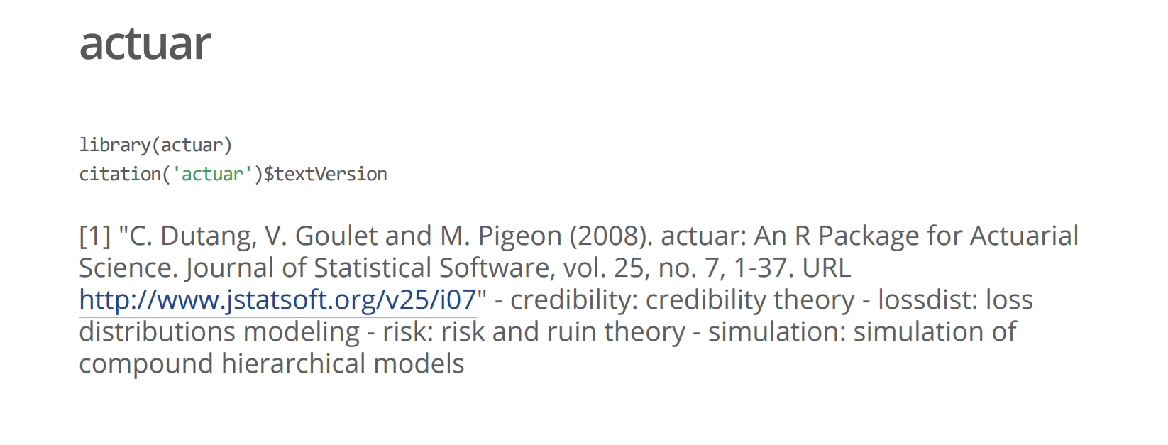
Use Cases: Finance and Actuarial Science Cont’d

Slide 10
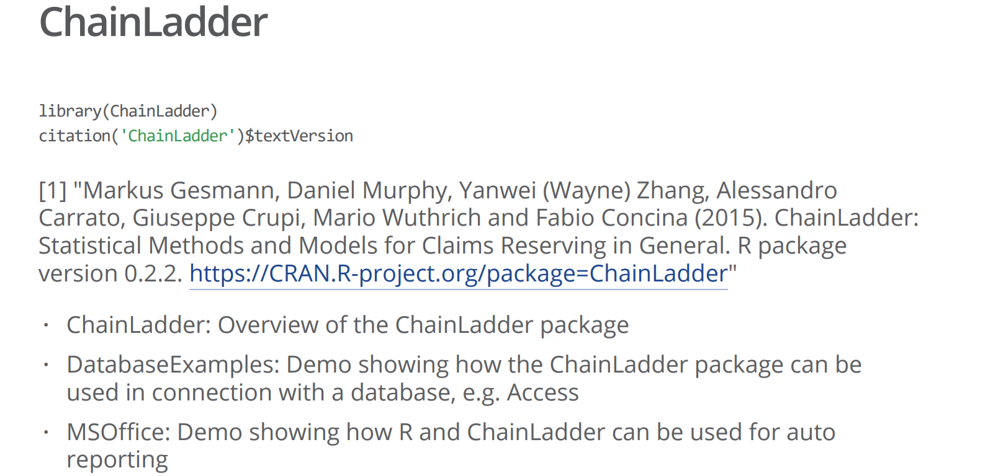
Use Cases: Finance and Actuarial Science Cont’d

Slide 11
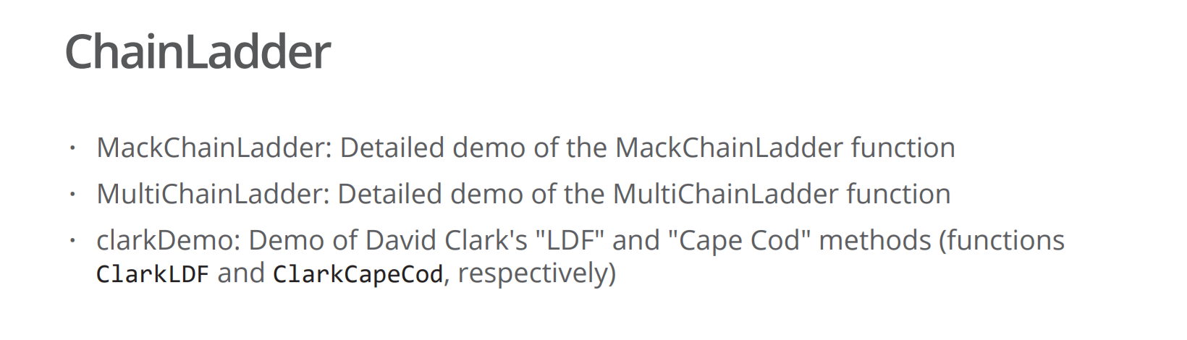
Use Cases: Finance and Actuarial Science Cont’d

Slide 12
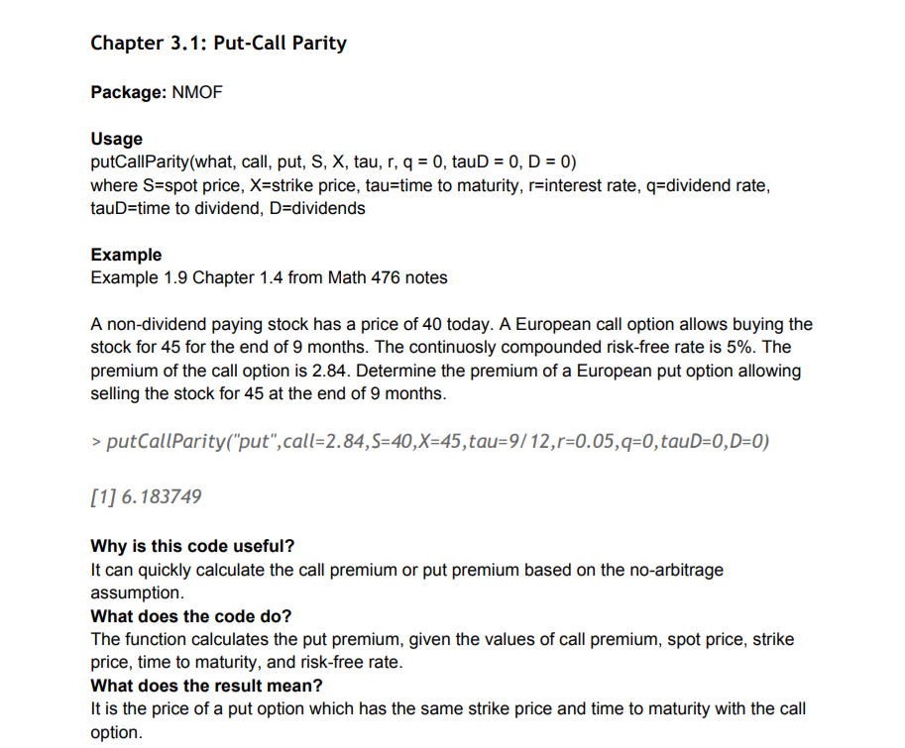
Use Cases: Finance and Actuarial Science Cont’d

Slide 13
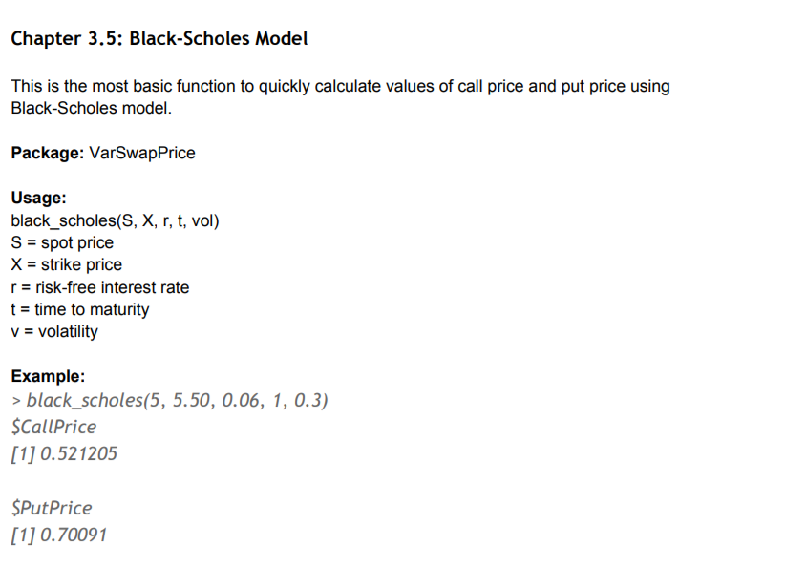
Use Cases: Finance and Actuarial Science Cont’d

Slide 14
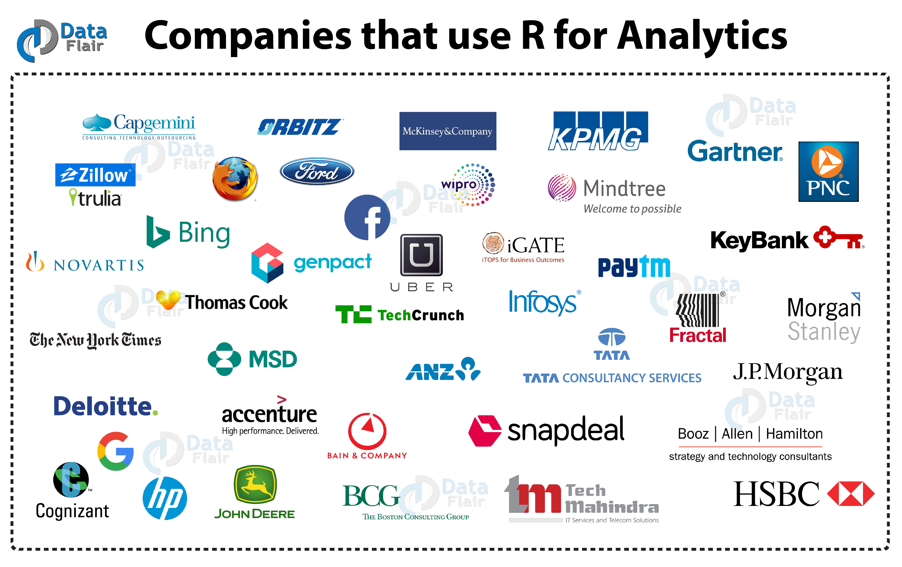

Slide 15

AfricaR
Mission:
To achieve improved representation and empower the African population of all genders, who are underrepresented in the global R community.
Support already existing R User Groups (RUGs) across Africa, and R enthusiasts to embrace the full potential of R programming.
Through fostering a collaborative continental network of R gurus, mentors, learners, developers and leaders, to help facilitate individual and collective progress worldwide.

Slide 16

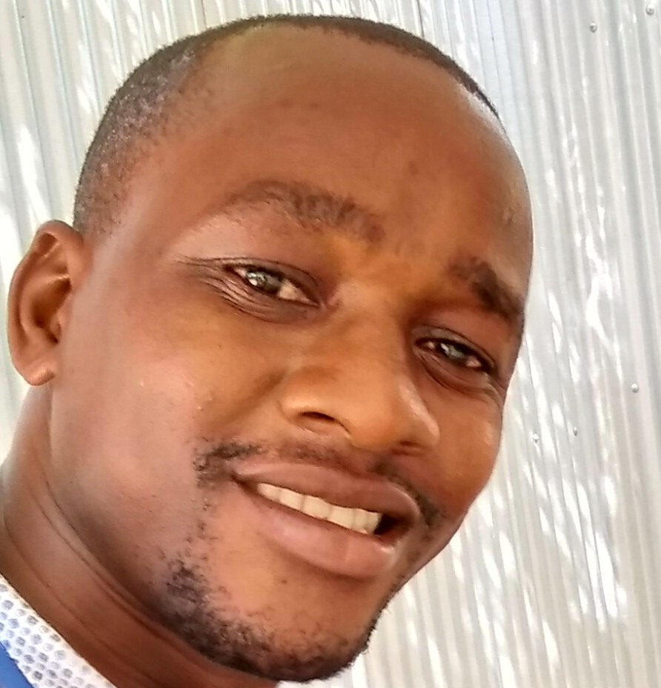
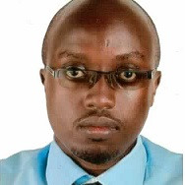
nairobi
Kigen Tembu
Data Scientist
MUSONI
Shelmith Kariuki
Senior Data Analyst
AfricaR
Christopher Maronga
Data Manager
KEMRI WELLCOME TRUST

Slide 17
nairobi : Objectives
Leverage open source R to impart practical data analytics skills.
Bring the current R users together.
Work with Kenyan universities, to re design the statistical R curriculum.
Introduce / enhance R in companies that work with data

Slide 18
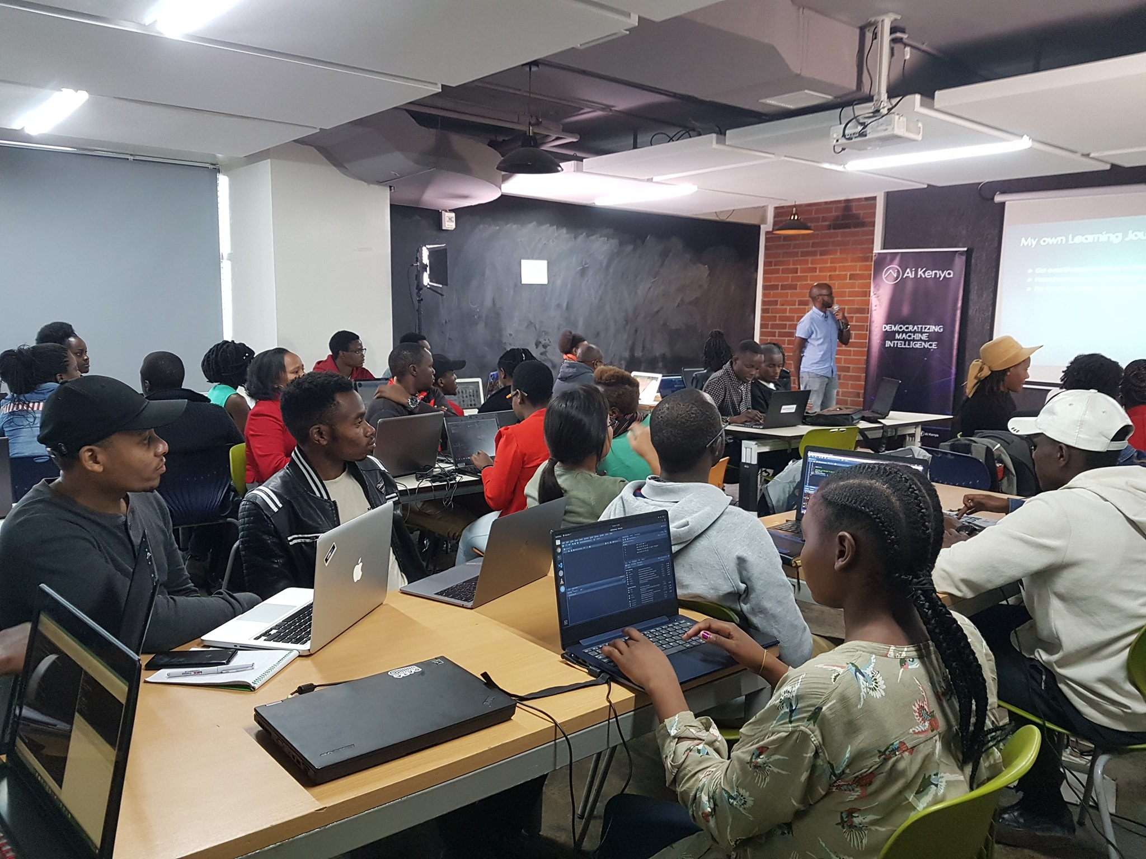
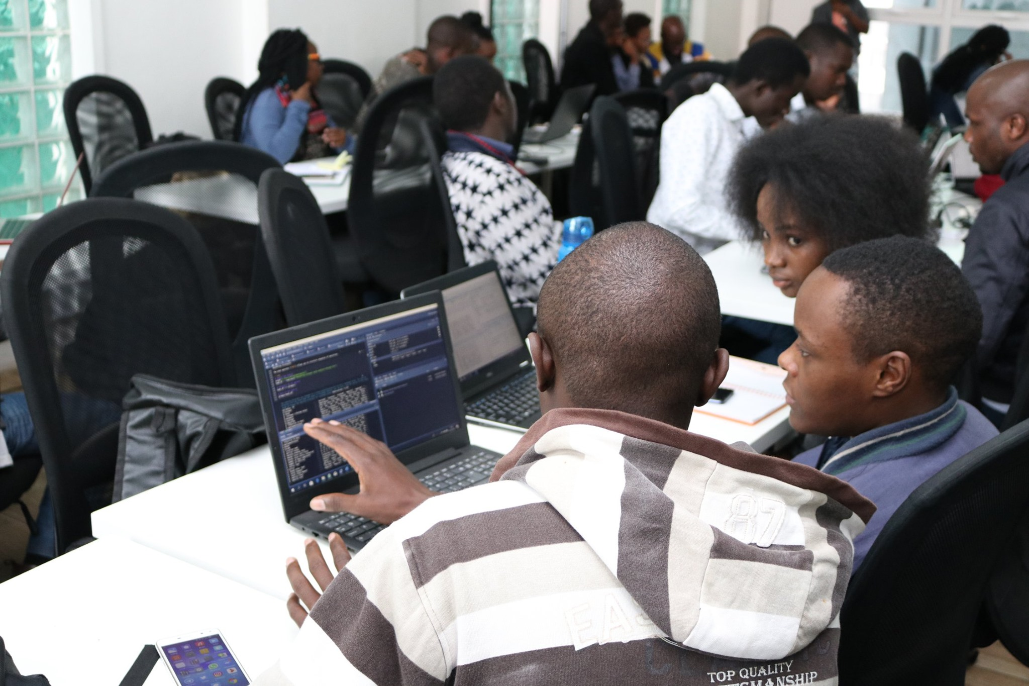
nairobi :
1st MeetUp @iHub
2nd MeetUp @ALX, Nairobi Garage

Slide 19
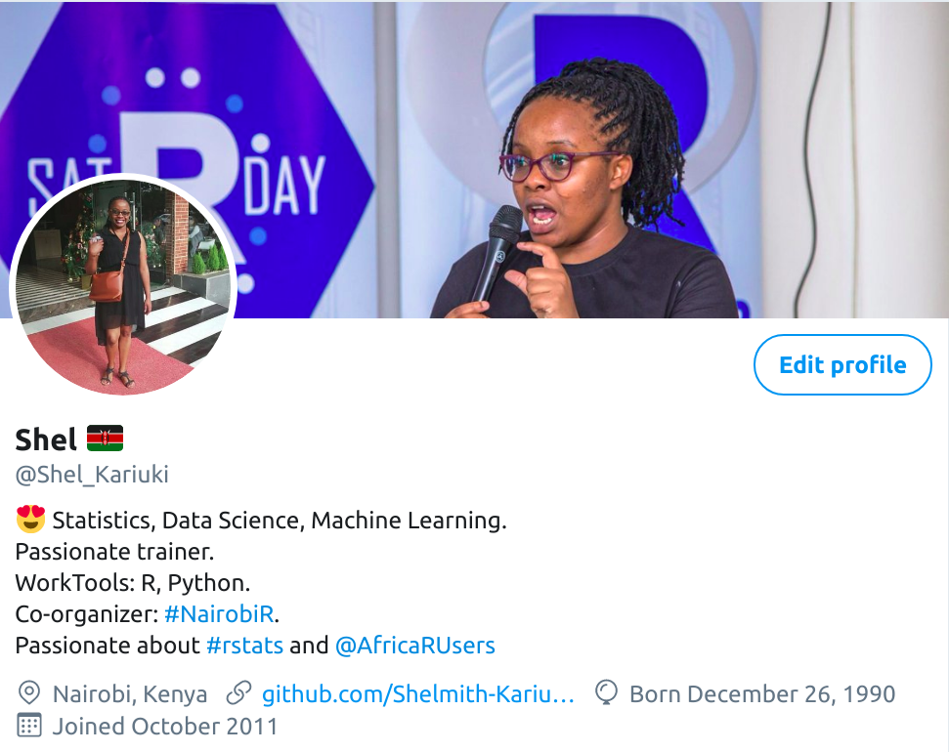
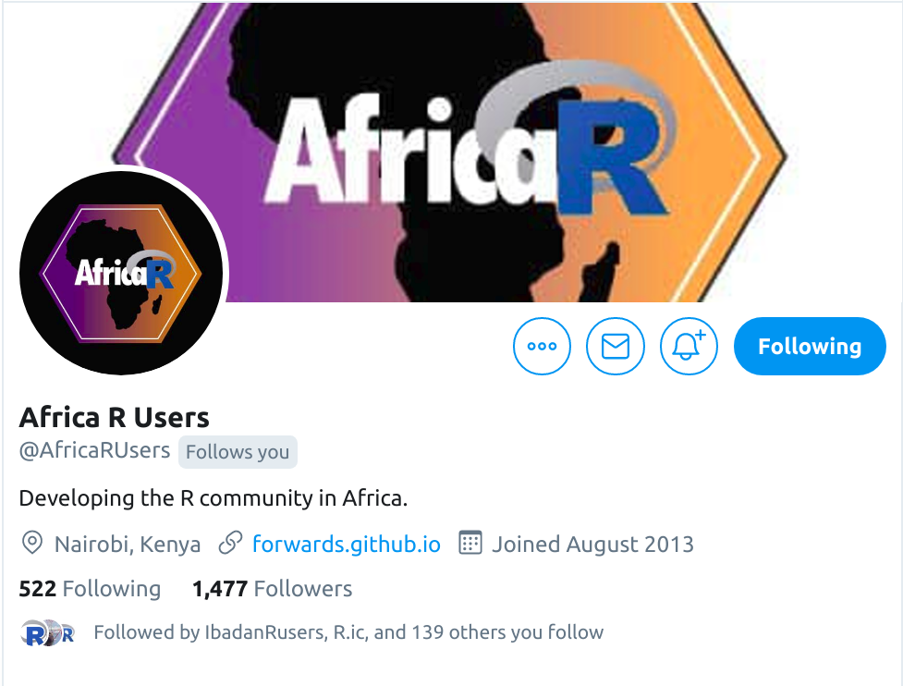
Follow us on twitter

Slide 20


